Slide 1
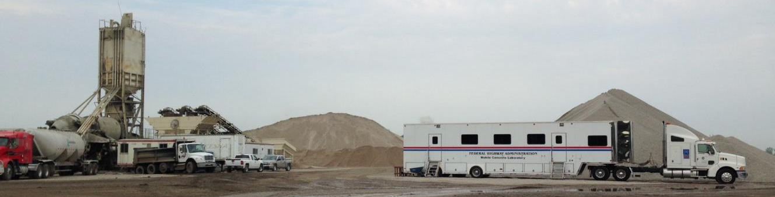
FHWA Mobile Concrete
Technology Center
(MCTC)
Taking Technology Transfer to the Next Level
Jim Grove, P.E.
ATI Inc / Consultant to FHWA

Slide 2
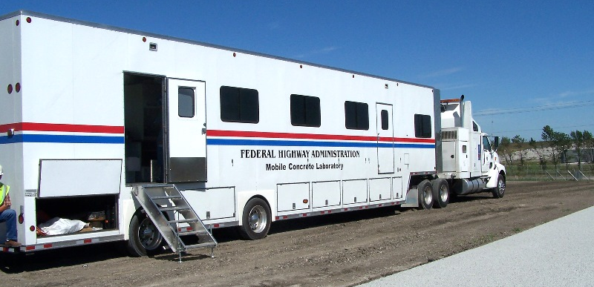
Change is the only constant!
Formally…..
The Mobile Concrete Laboratory
Then.....
The Mobile Concrete Trailer
Now…..
The Mobile Concrete Technology Center

Slide 3
Program Goals
Implement new and proven concrete technologies
Evaluate new tests and equipment
Demonstrate the benefits of statistical materials acceptance in both agency acceptance programs and industry quality control applications
Assist states with concrete issues
Specification review and development
Technical assistance
Forensics

Slide 4
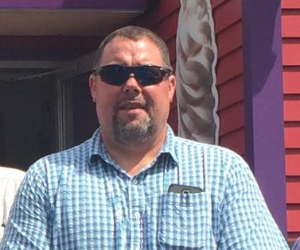
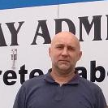


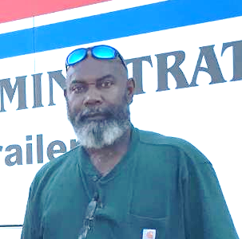
MCT Staff
Mike Praul
Nicolai Morari
Jagan Gudimettla
Jim Grove
Jerry Clemons

Slide 5
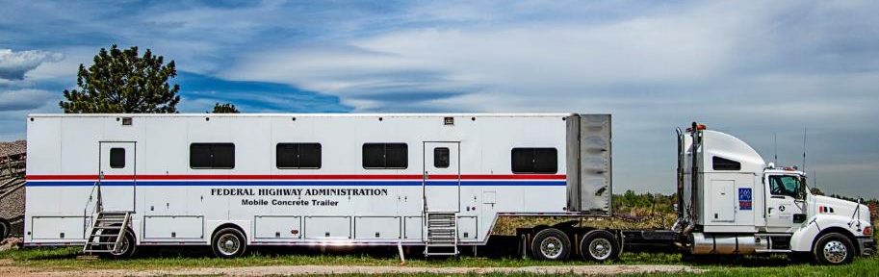
MCT Activities
Field visits to active construction projects
Quality in the Concrete Paving Process Workshop
Assist with (PEM) implementation
Equipment Loan Program
One-on-one Training
Conferences, papers, and other activities

Slide 6
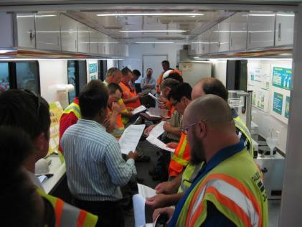
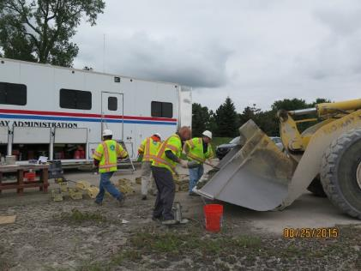
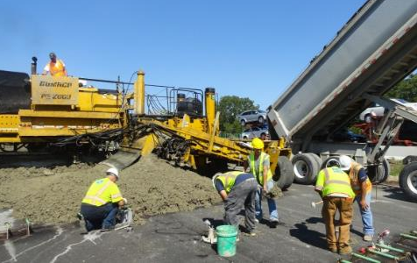
MCT Field Visits
Active field project for a two week period
Traditional and Innovative concrete testing
Data in control chart format
Kick-Off Meeting
Testing
Testing
Week 1

Slide 7
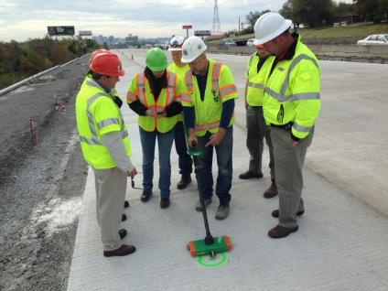
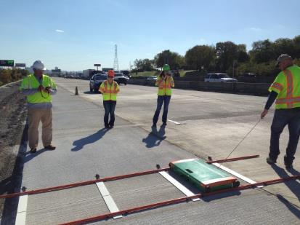
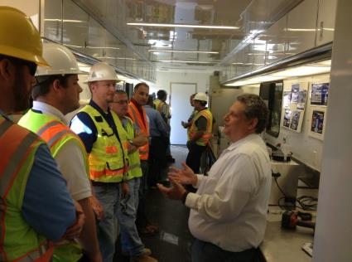
MCT Field Visits
NDT pavement testing
Conduct and Open House
Hold a Close-Out meeting
Testing
Testing
Open House
Week 2

Slide 8
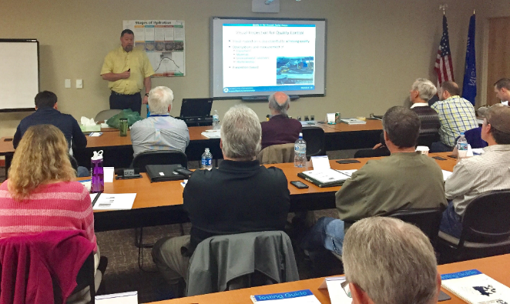
QA Workshop
Two-day workshop on the benefits a Quality Assurance Program
Agency and Contractor Participation
Quality in the Concrete Paving Process

Slide 9
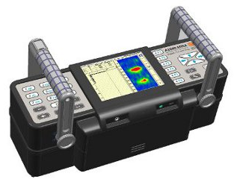
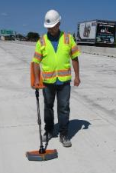
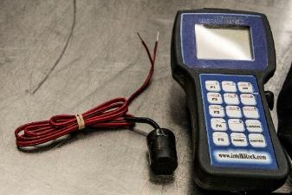
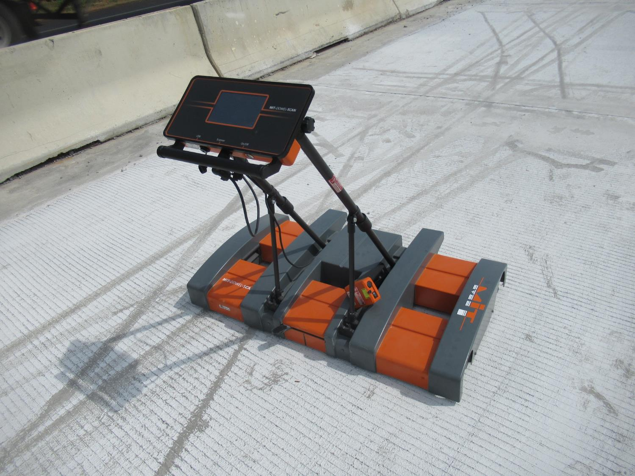
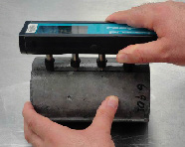
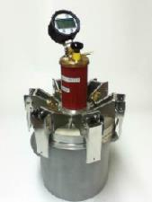
Equipment Loan Program
States or industry can borrow MCT equipment
MCT staff will provide training, if desired
Substantial new equipment purchase
PEM focus

Slide 10
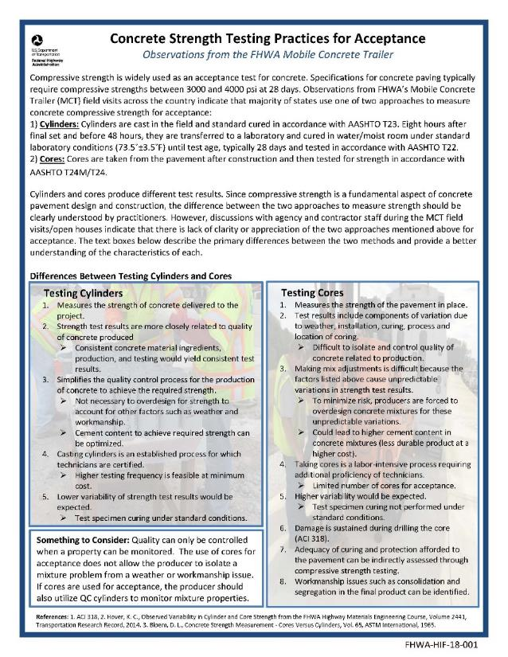


One Pagers
New effort to use MCT data
Narrowly focused
Meant to stir interest and point reader to resources
  1st : Cement Content
  2nd: Optimized Mix Design
  3rd : Cores vs. Cylinders
  4th : NDT Thickness Measurement
  5th: Surface Resistivity
  6th: Texture of Concrete Pavements
  7th: Maturity
  8th: Curing
  9th: SCMs
  10th: Calorimetry

Slide 11
MCT Visits
(since 2008)
ME
WA
NH
MT
ND
VT
OR
MN
ID
WI
MA
SD
NY
WY
MI
RI
NE
IA
PA
CT
NV
OH
NJ
CA
UT
IL
IN
CO
WV
VA
DE
KS
MO
KY
TN
NC
MD
AZ
NM
OK
AR
SC
MS
AL
GA
TX
LA
AK
FL

Slide 12
Resent New Technologies / Tests
Optimized Gradation
  Overall Durability
Super Air Meter
  Freeze -Thaw Durability
Surface Resistivity
  Permeability
Phoenix
  Water Content
MIT Scan T3
  Nondestructive Pavement Thickness
Dowel Scan
  Dowel bar alignment
PEM
Construction

Slide 13
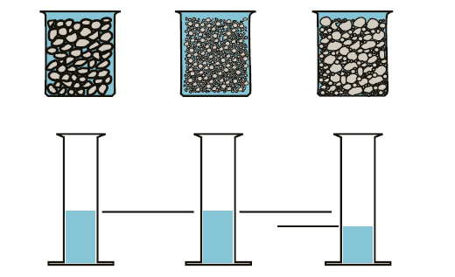
1. Optimized Combined Gradation
Maximize Aggregate Volume

Slide 14
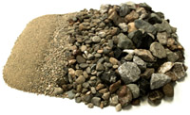
Optimized Combined Gradation
What will it do for me?
Less paste=> Lower permeability
Less paste=> Reduced thermal shrinkage
Less paste=> Reduced drying shrinkage
Less paste => Lower cost
Less paste => More sustainability

Slide 15
Reducing the Crack Tendency
Volume of Paste Calculations
% Paste should be less than 25% for lowering the crack tendency of concrete

Slide 16
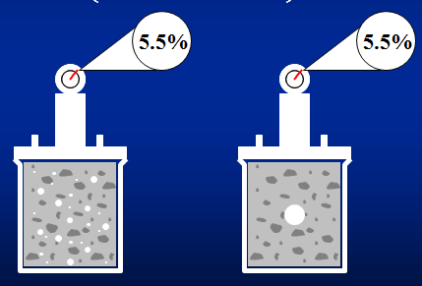
2. Air Content
Total air (4.0% - 8.0%)
Pressure air meter
  Measure total air in the field
  But, the air void system is what counts
Which is freeze / thaw durable?

Slide 17
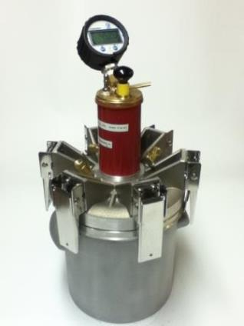
Super Air Meter (SAM)
Measures the Air Void System
Modification of existing air test
  Measures air system quality
  Small bubbles implode
  Test Method
    Test three times at different pressures
    Repeat
    Field friendly
    8-12 Minutes
    Measures total air content

Slide 18
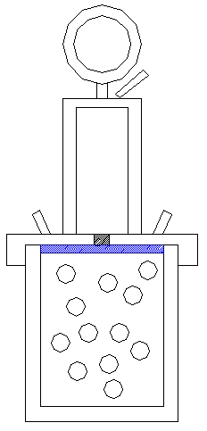
SAM Principle
Provisional Test Method
  AASHTO TP 118
2nd Pressure curve
45 psi
30 psi
SAM Number
Resultant Pressure
14.5 psi
1st Pressure curve
Standard air pot total air value
Time
Pressure Introduced

Slide 19
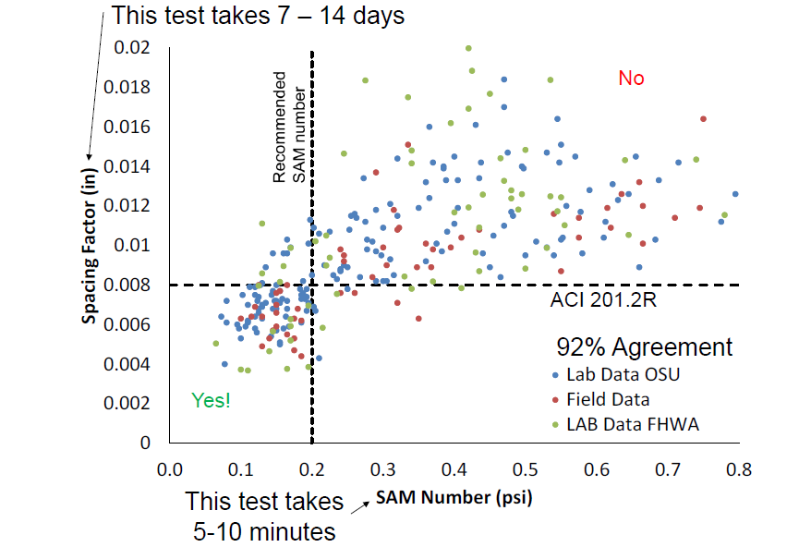
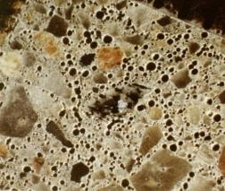
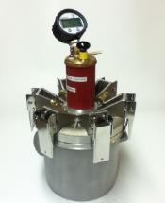
SAM vs. ASTM C457

Slide 20
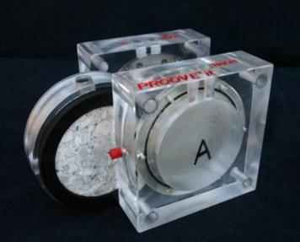
3. Permeability
Rapid Chloride Penetrability Test (Indirectly)
Became standard in 1981
Most common test
Indicator of vulnerability to water and chloride ingress
Generally 24 hours to condition and 6 hours for testing
AASHTO T 277

Slide 21
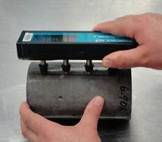
Permeability
(Surrogate Tests for Durability)
Surface Resistivity Test (Indirectly)
State specification
  Several states
28-day age is being used
Instant results on hardened concrete
Easily measures the right property
Non-destructive test
AASHTO T 358

Slide 22
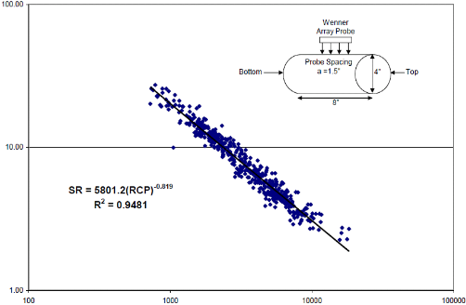
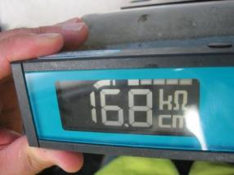
Permeability
Surface Resistivity Test matches well with Rapid Chloride Penetrability Test
Surface Resistivity (KOhm-cm)
Florida DOT
RCP (Coulombs)

Slide 23
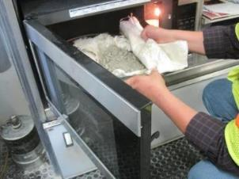
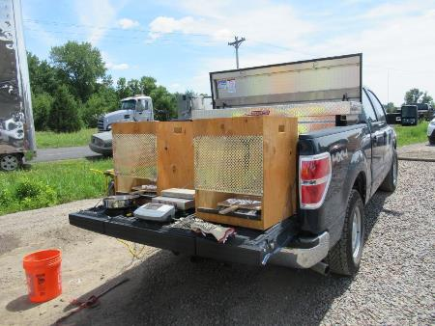
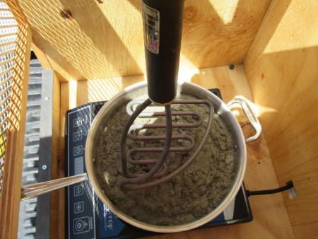
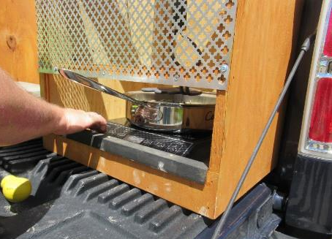
4. Phoenix
New test to measure the water in fresh concrete
Developed by Dr. Tyler Ley, Oklahoma State University
Easy to operate
Once the test begins, no attention is required
Run it on the back of a pickup
A hot plate and a “branding iron” heat the concrete

Slide 24
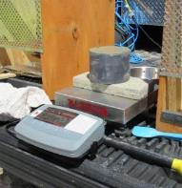
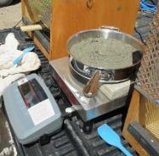

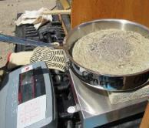
Phoenix Procedure
Step 1
Step 2
Measure unit weight of Concrete
Weigh the pan and concrete
Step 3
Step 4
Heat the concrete
Weigh the pan and concrete

Slide 25
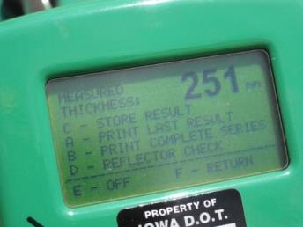

Pulse Induction Technology
Advantages
Easy to use
High accuracy
Non-destructive
Almost real time
Rapid measurement
Significant cost savings
Independent of the base material

Slide 26
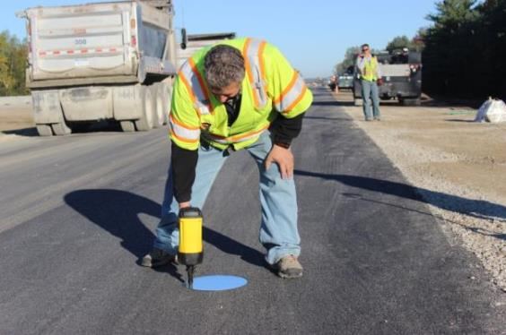
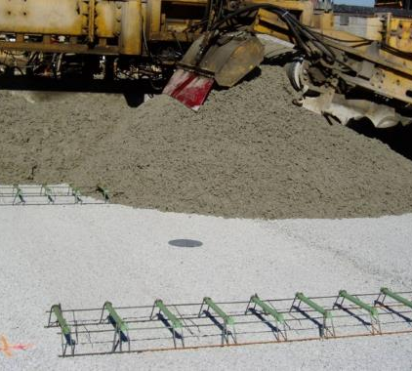
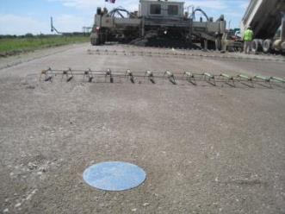
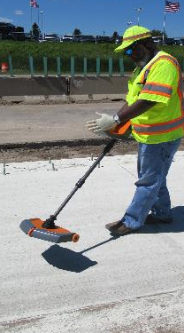
Pulse Induction Technology
MIT Scan T3
Step 1
Step 2
Step 3
Place the target
Pave over it
Locate the target
Quality Control and Agency Acceptance
AASHTO Test Method (AASHTO T 359-18)
ASTM Test Method in the works

Slide 27
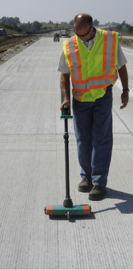
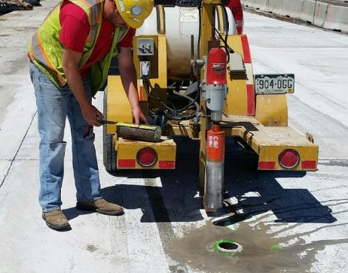
Pulse Induction Technology
MIT Scan T3
FHWA Mobile Concrete Trailer Data

Slide 28
State of the Practice
Full-Fledged Implementation
Iowa DOT
Wisconsin DOT
Minnesota DOT
West Virginia DOT
Illinois Tollway
Alabama DOT
Nevada DOT
Pennsylvania DOT
Implementing in 2019
Washington State DOT
North Dakota DOT
2019 or beyond
Delaware DOT
Florida DOT
Indiana DOT
North Carolina DOT
Arizona DOT

Slide 29
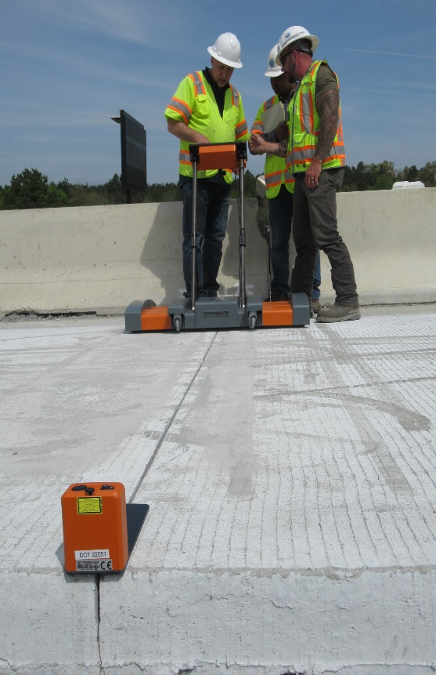
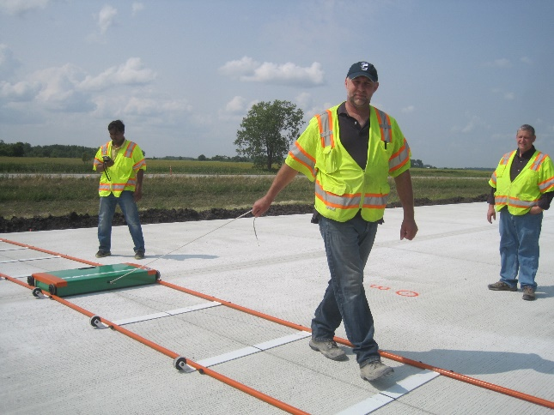

Pulse Induction Technology
Dowel Scan
No track is required
Utilizes a laser
Has wheels so it can move on the pavement

Slide 30

Field visits 2019
ME
WA
NH
MT
ND
VT
OR
MN
ID
SD
WI
WY
MI
NY
RI
NV
NE
IA
PA
NJ
UT
IL
IN
OH
CA
CO
WV
DE
KS
MO
KY
VA
TN
NC
MD
AZ
NM
OK
AR
SC
MS
AL
GA
TX
LA
AK
FL

Slide 31
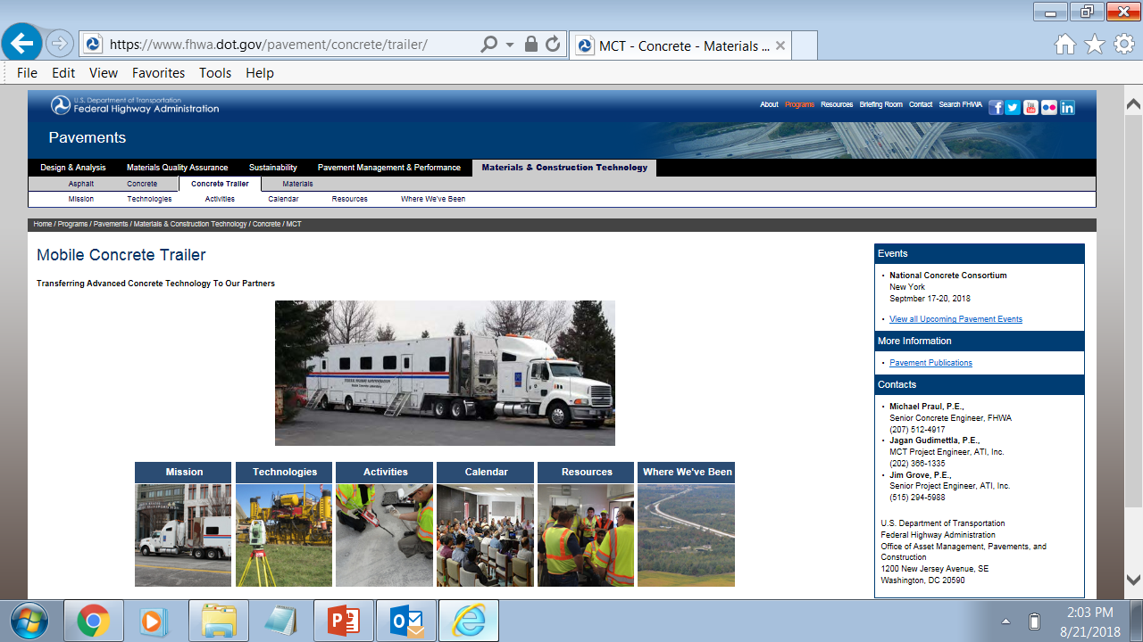
MCT Website
https://www.fhwa.dot.gov/Pavement/concrete/mclfly.cfm

